Slide 1
How innovating firms manage knowledge leakage:
A natural experiment on the threat of worker departure
Hyo Kang
USC Marshall
hyokang@marshall.usc.edu
Wyatt Lee
Toronto Rotman
wyatt.lee@rotman.utoronto.ca
HEC Paris Entrepreneurship Workshop
December 11, 2021

Slide 2
Research Overview
Research Question
How do firms protect knowledge against leakage?
We study threat of worker departure as the key mechanism through which firms decide on knowledge protection strategies
Overview
Patents
Secrecy
Firm characteristics
Knowledge characteristics
Legal protection
Setting
Design
Results
Mechanisms
Discussion
The Threat of Worker Departure
Notes:
Firms in knowledge-based industries must constantly innovate to create a competitive advantage. To sustain that advantage, firms must also protect their knowledge from leakage to competitors
A pivotal decision that innovating firms must make with regard to knowledge protection is whether to rely on patents or alternative protection mechanisms, notably secrecy

Slide 3
Research Overview
Empirical setting
Application v. Hunter (1998) decision
Out-of-state noncompetes not enforceable in California
Empirical Method
Difference-in-differences
Overview
Setting
Design
Results
Mechanisms
Discussion
Notes:
Firms in knowledge-based industries must constantly innovate to create a competitive advantage. To sustain that advantage, firms must also protect their knowledge from leakage to competitors
A pivotal decision that innovating firms must make with regard to knowledge protection is whether to rely on patents or alternative protection mechanisms, notably secrecy
Affected non-California firms
Created a loophole in the enforcement of noncompetes

Slide 4
Main Findings
Firms increased patent filings by about 4.6%
The effect is greater for firms
that are large (up to 26%)
in complex product industries (vs. discrete)
in fast-growing industries (vs. stationary)
located in Maryland where the court decision was more salient
A placebo test: individual inventors showed little effect
Tests on the mechanism: e.g., the existence of trade secret
Overview
Setting
Design
Results
Mechanisms
Discussion

Slide 5
Noncompete enforcement in California
Noncompetes: workers agree not to work for a competing firm
In-state noncompetes not enforceable in California
Muggill v. Reuben H. Donnelley Corp. , 62 Cal.2d 239 (1965)
California Business & Professional Code Section 16600
Out-of-state noncompetes in California
Written between a non-CA employer and a non-CA employee
Construed to be enforceable until the 1998 decision
Overview
Setting
Design
Results
Mechanisms
Discussion
Notes:
https://www.businessjustice.com/is-my-out-of-state-noncompete-agreemen
a California employer cannot get around California’s prohibition against employee restrictive covenants by requiring his California employee to sign an agreement that includes a Nevada choice-of-law clause.
This is because California courts will not apply the law of another state where that law is “contrary to a fundamental public policy of the State of California.” See, e.g., Application Grp., Inc. v. Hunter Grp., Inc., 61 Cal. App. 4th 881, 902 (1998).
t-enforceable-in-californi.html

Slide 6
Application v. Hunter (1998)
Out-of-state noncompetes not enforceable in CA
Applied California law even if the contract
was signed between a MD firm and a MD resident
stated that it should be construed under Maryland law
“California has a strong interest in protecting the freedom of movement of persons … regardless of the person’s state of residence”
Came into effect immediately and retrospectively
Has advantages over legislative changes
Set a strong legal precedent
Non-CA firms suddenly face the threat of worker departure
Overview
Setting
Design
Results
Mechanisms
Discussion

Slide 7
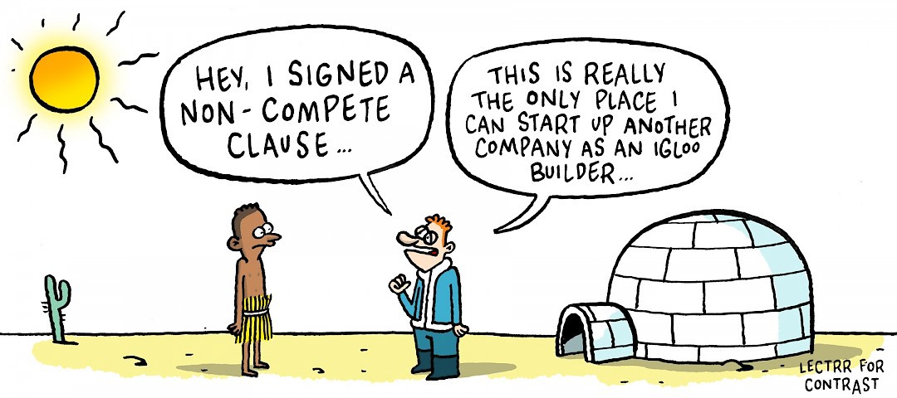

Application v. Hunter (1998)
BEFORE 1998
Overview
Setting
Design
Results
Mechanisms
Discussion
“Non-Californian employees will flock to California to avoid their non-compete”
(Wu, 2003; p. 605)
AFTER 1998
Notes:
. We find that a legal decision in a single state could affect all firms nationwide, highlighting the roles of third parties on firm strategies. Business environments that shape firm strategies are a complex combination of not only local but also broader (even global) policy and legal institutions. Businesspeople and policymakers should carefully consider how policy or legal institution affect regions outside their intended area as well as their own state. Methodologically, this approach mitigates an endogeneity concern, because California’s court decision is much less correlated with non-California firms (if any) than with California firms.

Slide 8
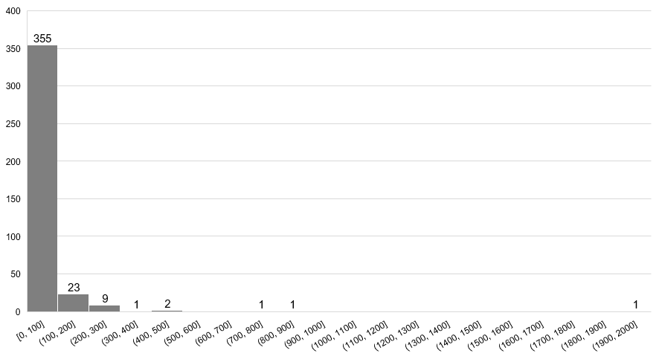
Application v. Hunter (1998) – A Strong Precedent
Histogram
Forward citations of noncompetes-related court cases in 1998 (N=393)
Overview
Setting
Design
Results
Count
Mechanisms
Discussion
Application v. Hunter (1998):
769 citations
# forward citations
Notes:
From an employer’s perspective, non-California firms faced an unexpected “loophole” in the enforceability of their non-competes, as the decision made all existing non-competes suddenly void in California.

Slide 9
Application v. Hunter (1998) – A Strong Precedent
Qualitative analysis:
Signature MD, Inc. v. MDVIP, Inc., 2015 U.S. Dist. (United States District Court for the Central District of California)
Online appendix A.2
Overview
Setting
When a covenant not to compete contains a choice-of-law provision, well established California choice-of-law principles apply such that California will likely be found to have a materially greater interest in enforcing its strong public policy, as reflected in Section 16600, of maintaining employment mobility. See Application Grp. v. Hunter Grp., 61 Cal. App. 4th 881, 896-97, 899-902, 72 Cal. Rptr. 2d 73 (1998).
Design
Results
Mechanisms
Discussion
Notes:
The decision suddenly denied firms’ ability to use noncompetes to prevent their workers’ outbound mobility to California and significantly increased the threat of worker departure faced by non-California employers.

Slide 10
Application v. Hunter (1998) – A Strong Precedent
Qualitative analysis: Interviews
A California attorney (has been practicing since 1998) “Hunter was probably the very high point of a practice that was common: file a declatory judgement action in California to invalidate the out-of-state non-compete of a non-California resident employee … Application Group was kind of the far reaches of attacking non-CA contract in a CA court”
A law professor (areas of expertise: employment law, choice-of-law) “I think this case … not clear to me why California law should apply to a contract between a Maryland employee and a Maryland employer with a Maryland choice-of-law clause.”
Overview
Setting
Design
Results
Mechanisms
Discussion
Notes:
The decision suddenly denied firms’ ability to use noncompetes to prevent their workers’ outbound mobility to California and significantly increased the threat of worker departure faced by non-California employers.

Slide 11
Research Design
Difference-in-Differences
Treatment: “the threat of worker departure”
We compare non-CA firms
Application v. Hunter (1998) only affected firms that had been enforcing non-competes
Treatment group: non-CA firms in the strong enforcement states
Control group: non-CA firms in the weak or non-enforcement states
$$y_{ist}={Enforce}_{s}⋅Post_{t}+δ_{is}+γ_{t}+ε_{ist}$$
Overview
Setting
Design
Results
Mechanisms
Discussion

Slide 12
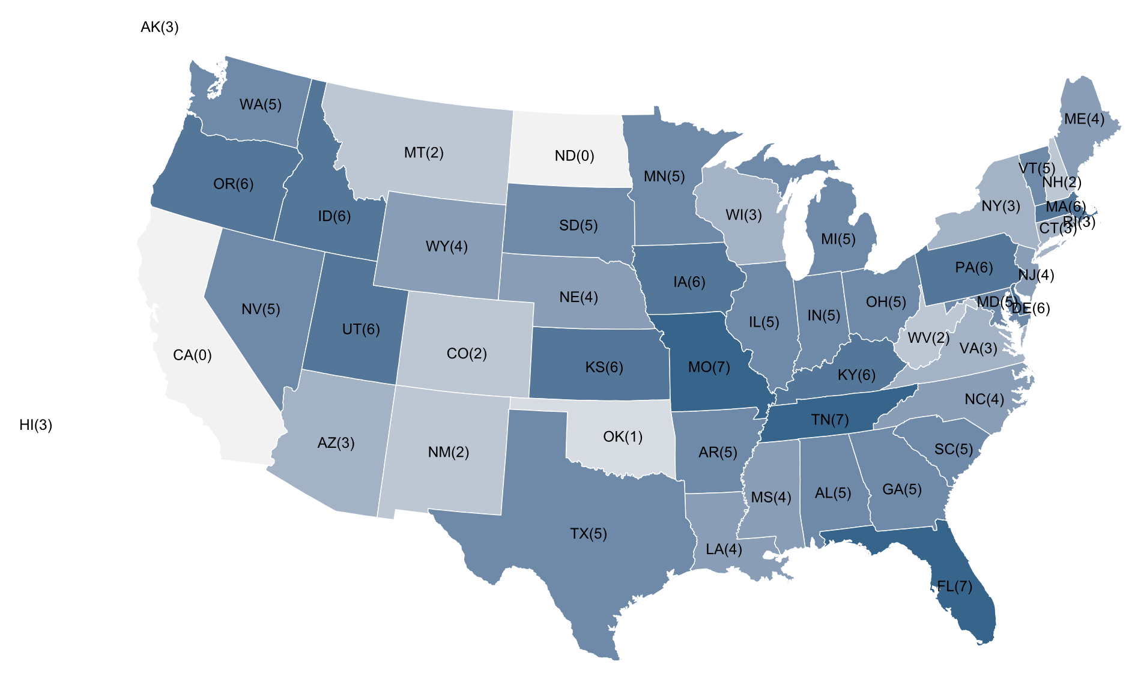
Research Design: Noncompetes Enforceability
Overview
Setting
Design
Results
Mechanisms
Discussion
Garmaise (2011) Index
Based on Marlsberger (2004) survey
[0 - 9]
Starr (2019) Index as of 1991
Based on Bishara’s (2011) ranking
[-4.23, 1.15]

Slide 13
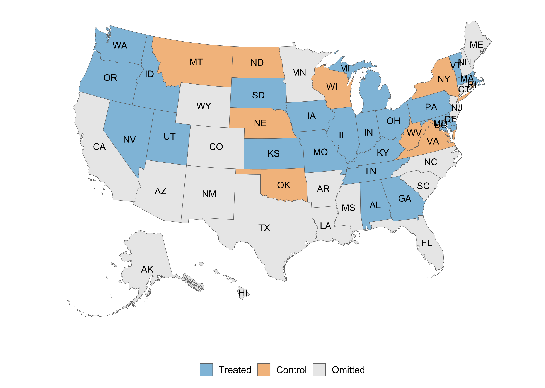
Research Design: Noncompetes Enforceability
Noncompetes enforceability: Garmaise (2011) and Starr (2019)
Enforce=1 if a state’s enforceability is >median score in both indices
Overview
Setting
Design
Results
Mechanisms
Discussion

Slide 14




Firms Will Increase Patent Filings
Firms have a range of options to protect knowledge:
Firms will increase patenting when facing a threat of worker departure
The efficacy of secrecy ↓ patenting →, ↑
Pre-emptive patenting
To gain bargaining power against workers
Patents
Secrecy
Overview
Setting
Design
Results
Mechanisms
Discussion
Notes:
Workers can demand higher wages (more outside options)
Firms want to preemptively file a patent, before their previous worker does it without them

Slide 15
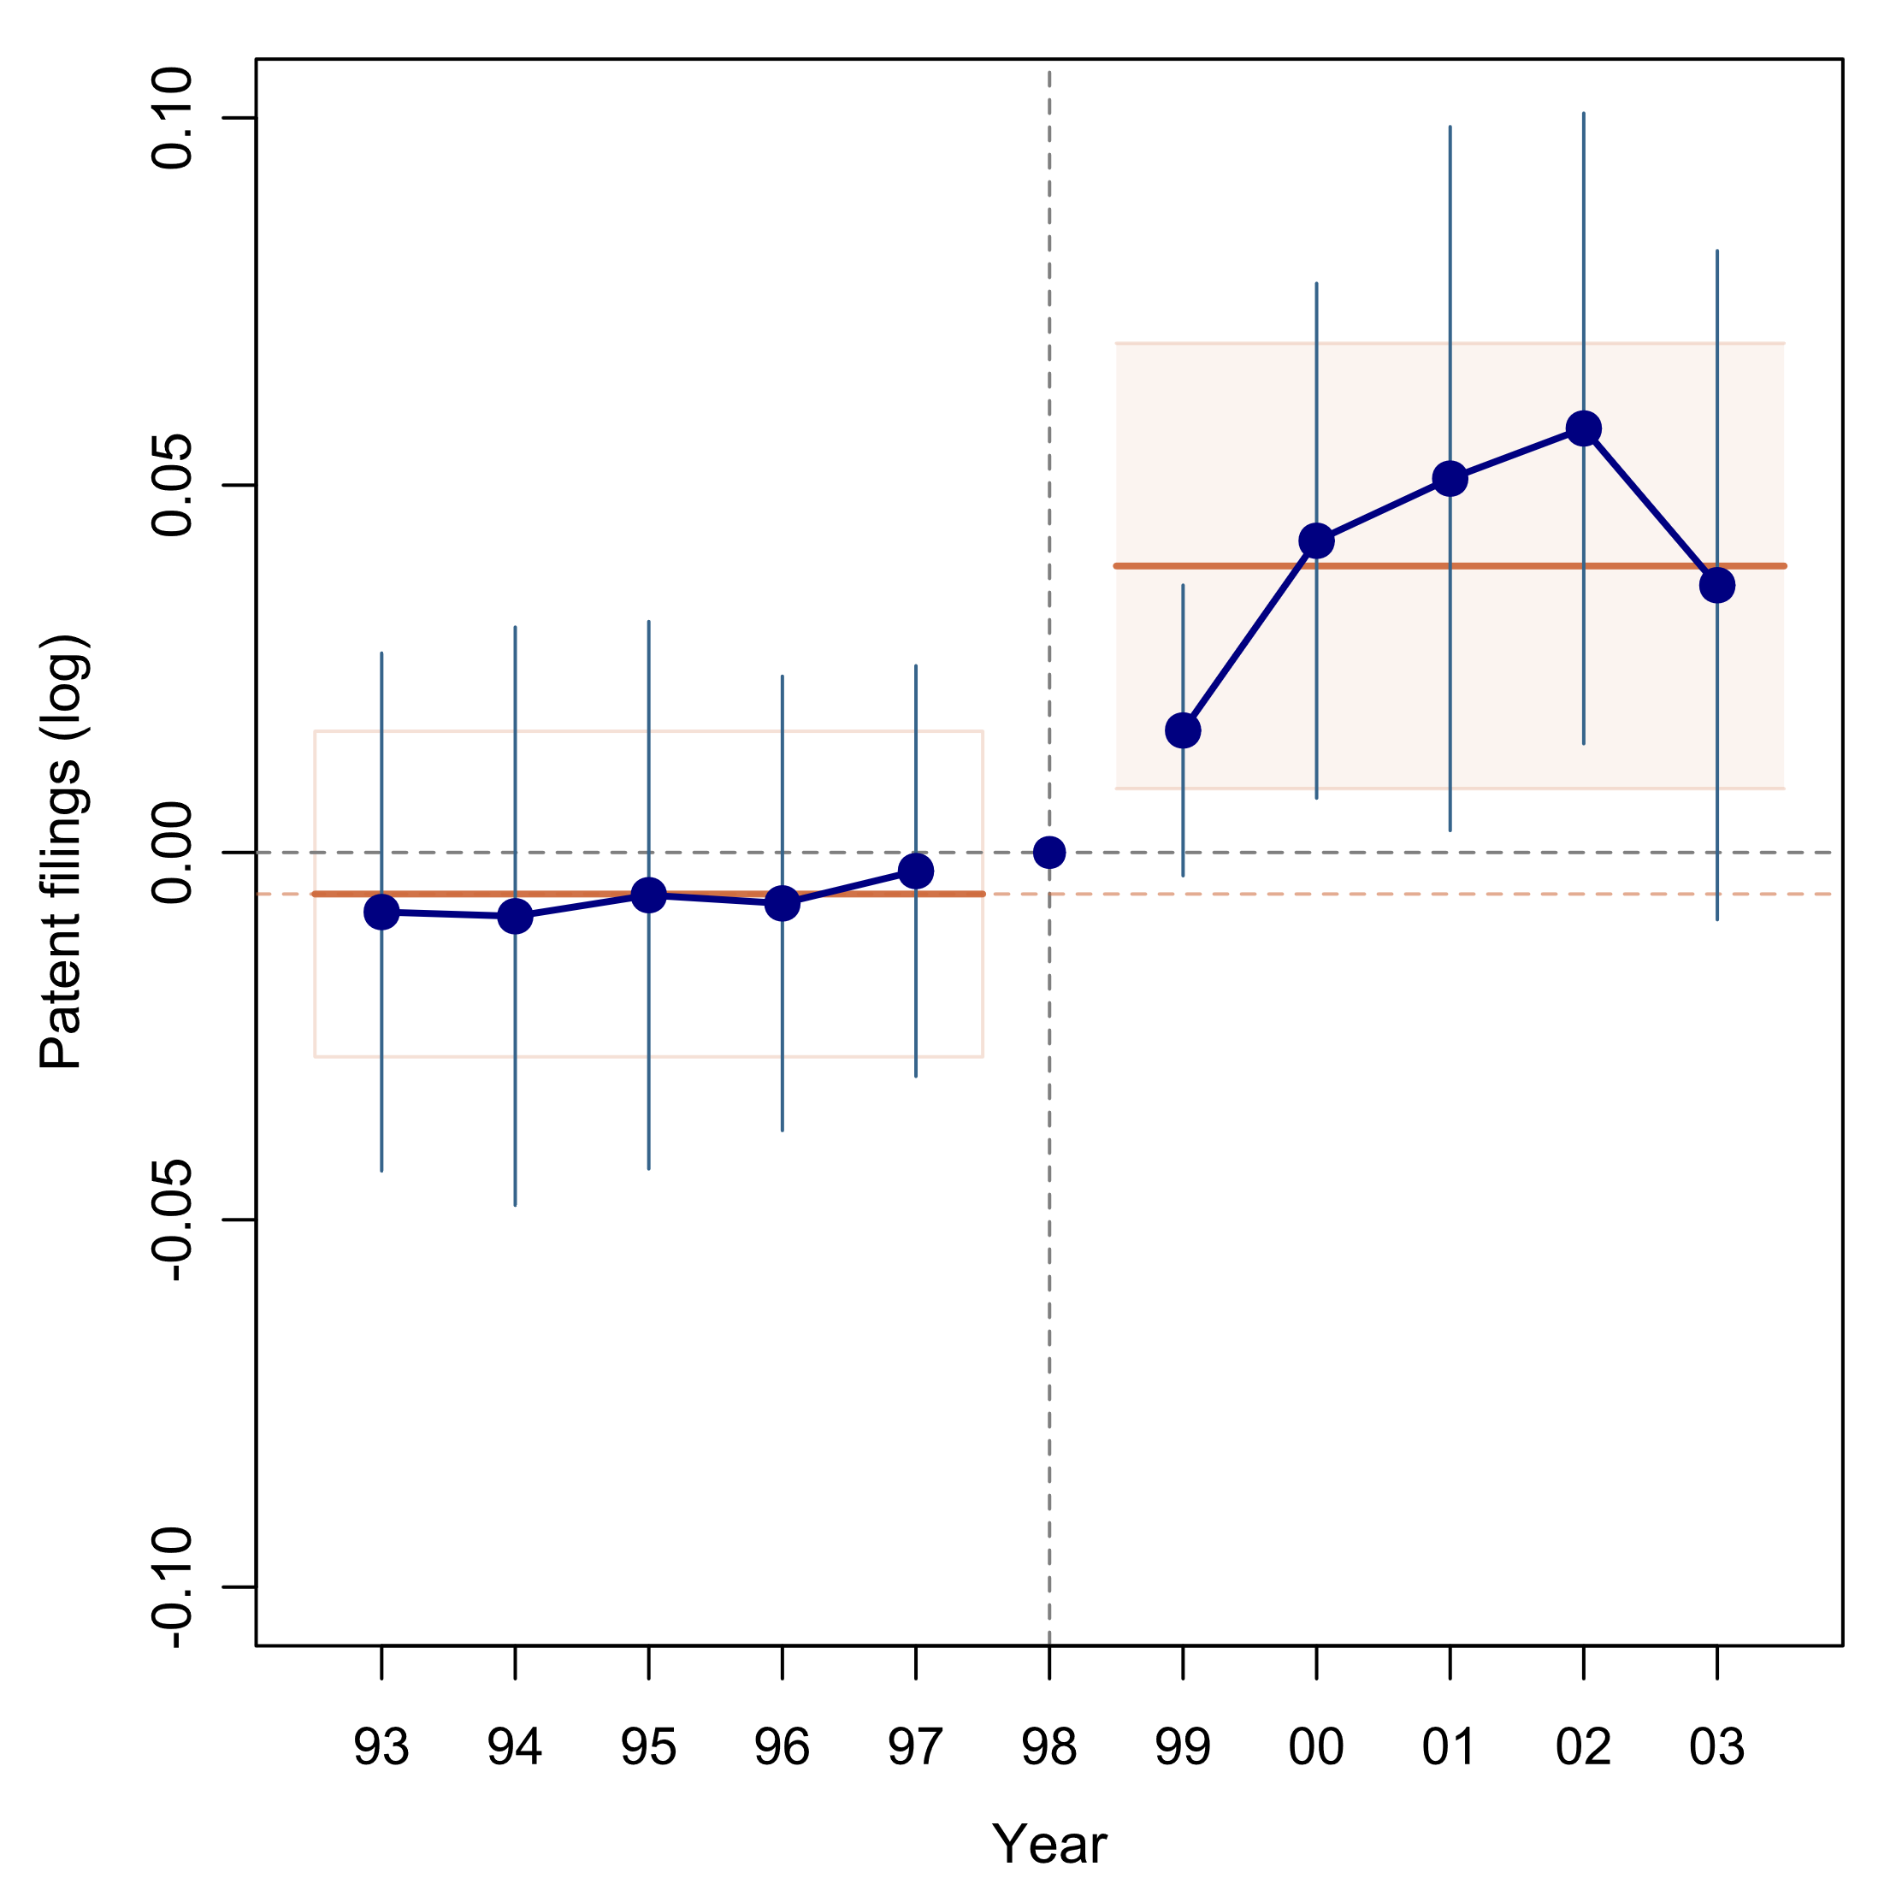
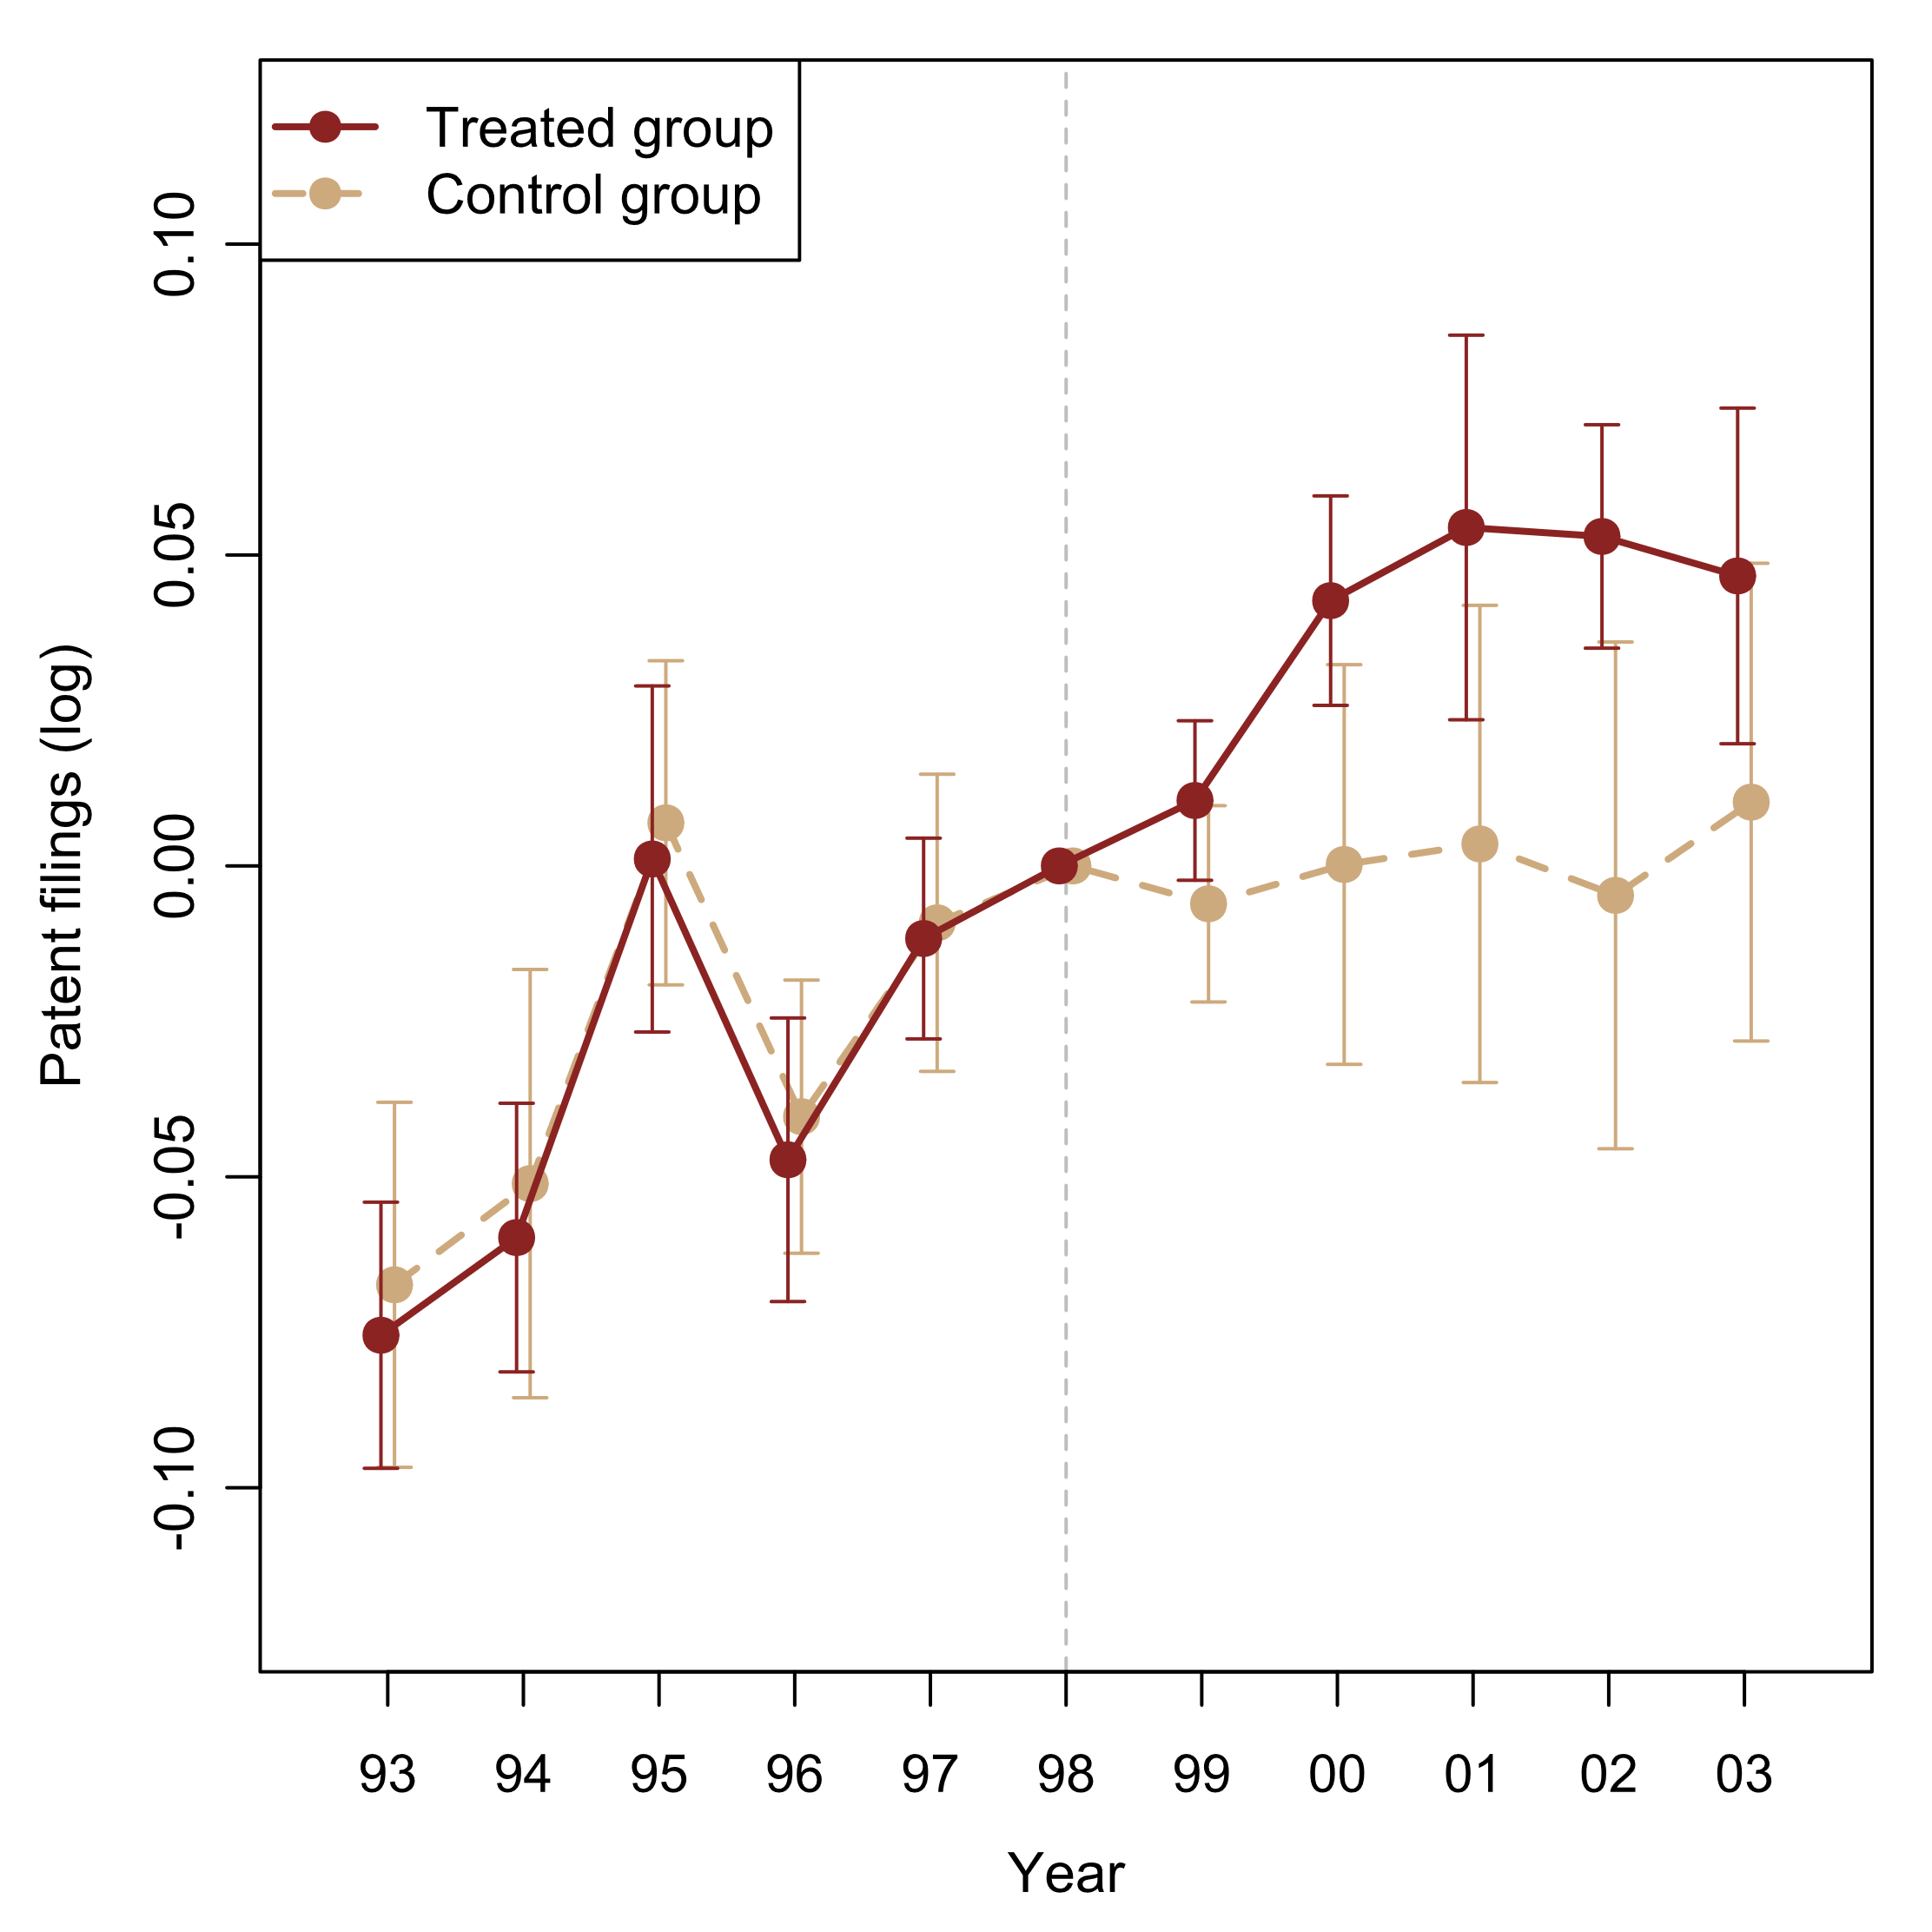
Result: Firms Increased Patent Filings
Treated firms increased patent filings by 4.6%
Propensity to patent
Overview
Setting
Design
Results
Mechanisms
Discussion
DiD with Distributed
Leads and Lags
Separate Event Studies for
Treated and Control Groups

Slide 16
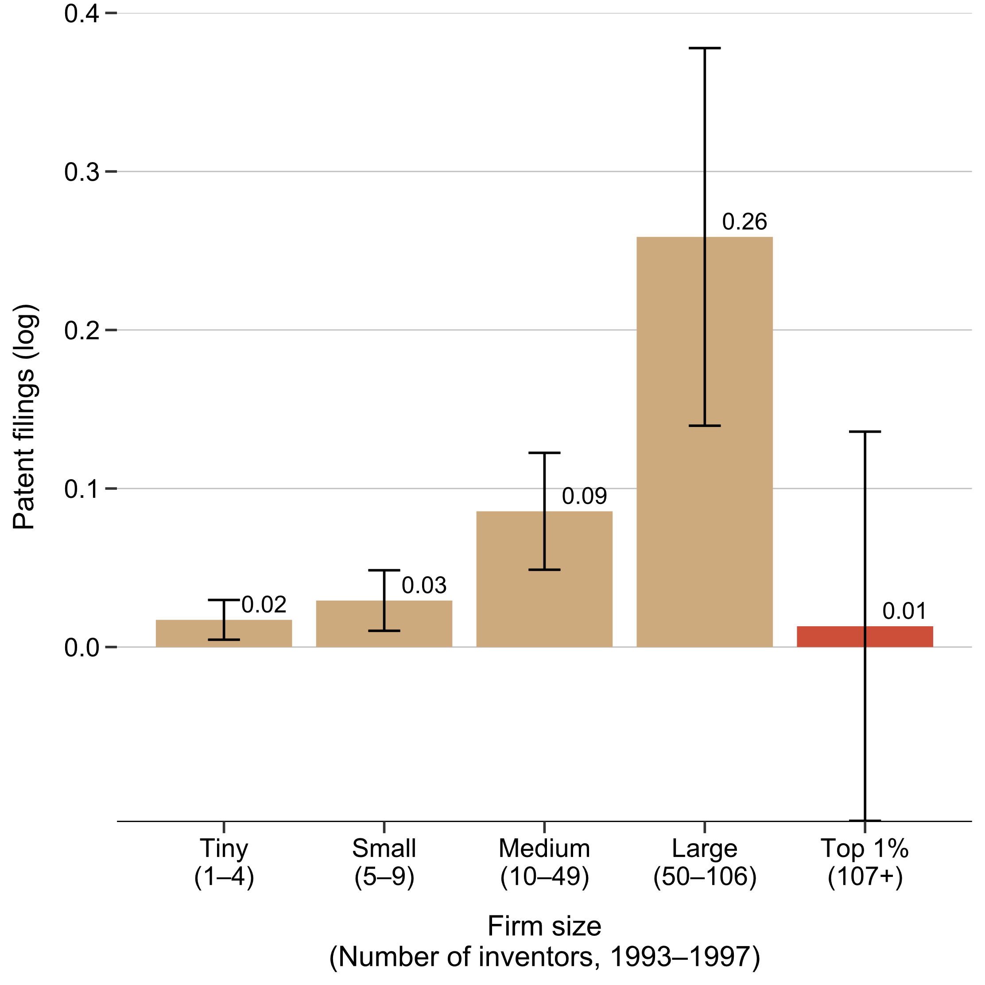
Result: Firm Size Heterogeneity
The effects are greater for Medium- and Large-sized firms
Huge corporations (top 1%) show little effect
Microsoft, Motorola, Boeing, Lockheed Martin, and Whirlpool
Dedicated, in-house patent attorneys for their patent filings, maintenance, and enforcement
Heterogeneity by firm size
Overview
Setting
Design
Results
Mechanisms
Discussion

Slide 17
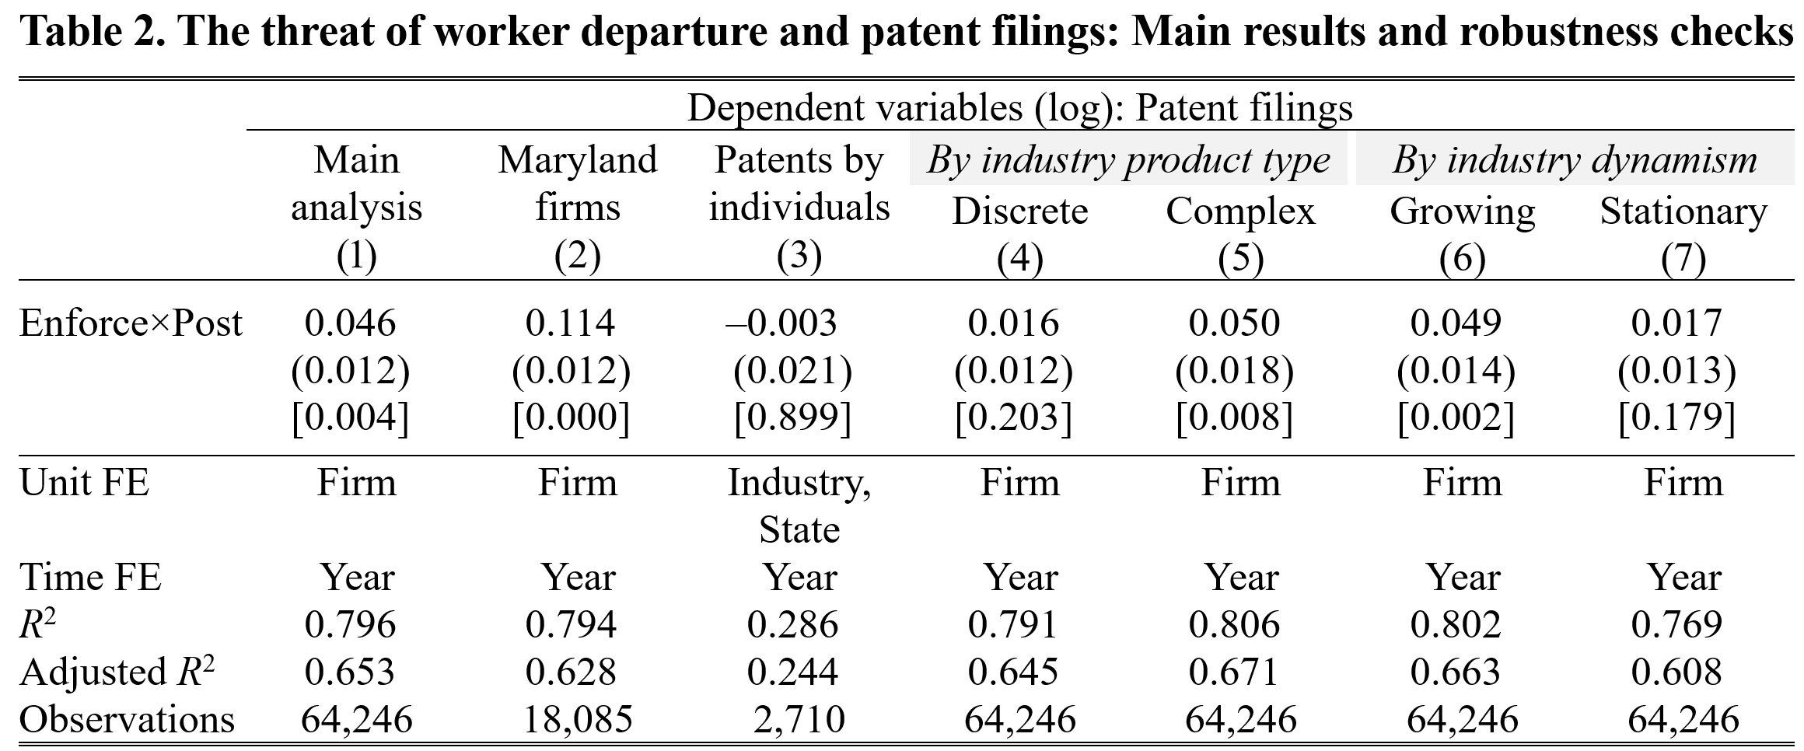
Result: Industry Characteristics
The effects are greater in complex product and fast-growing industries
and Maryland (court decision was more salient)
No effect for individual inventors (a placebo test)
Overview
Setting
Design
Results
Mechanisms
Discussion
p-value:

Slide 18
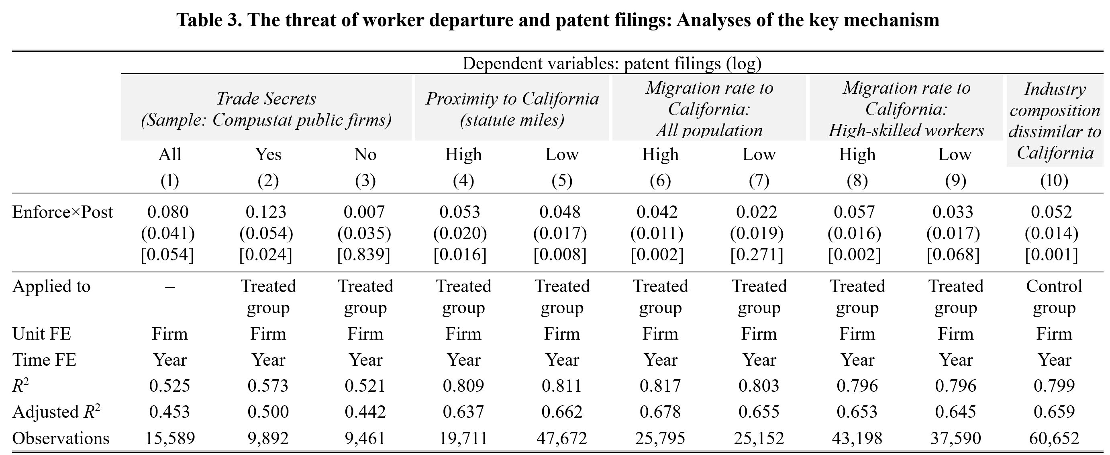
Tests of the Mechanism
DV: Patent filings
Trade Secrets
US Security Act Regulation S-K requires public firms with trade secrets to discuss the misappropriation risk in Form 10-K
Intel: “we own and develop significant IP and related IP rights … Our IP portfolio includes patents, copyrights, trade secrets, trademarks, mask work, and other rights”
Firms with trade secrets should respond
Trade Secrets
Overview
Proximity to CA
Setting
Design
Results
Migration rate to CA (Population)
p-value:
Mechanisms
Discussion
Migration rate to CA (High-skilled workers)
Industry composition dissimilarity to CA

Slide 19
Discussion
Firms patent strategically (knowledge creation + protection)
Patent counts may not capture firms’ fundamental innovation activities accurately
Application v. Hunter (1998): a novel identification strategy
Mitigates endogeneity concerns
Applied retrospectively to existing workers, creating an immediate threat
Legal enforcement in one state has far-reaching consequences outside of the focal state
Overview
Setting
Design
Results
Mechanisms
Discussion

Slide 20

Thank You!
Notes:
. We find that a legal decision in a single state could affect all firms nationwide, highlighting the roles of third parties on firm strategies. Business environments that shape firm strategies are a complex combination of not only local but also broader (even global) policy and legal institutions. Businesspeople and policymakers should carefully consider how policy or legal institution affect regions outside their intended area as well as their own state. Methodologically, this approach mitigates an endogeneity concern, because California’s court decision is much less correlated with non-California firms (if any) than with California firms.

Slide 21
Main Findings
Firms increased patent filings by about 4.6%
The effect is greater for firms
that are large (up to 26%)
in complex product industries (vs. discrete)
in fast-growing industries (vs. stationary)
located in Maryland where the court decision was more salient
A placebo test: individual inventors showed little change in patent filings
Five tests on the mechanism
Overview
Setting
Design
Results
Mechanisms
Discussion

Slide 22
Application v. Hunter (1998): Implications
Not necessarily mean that incoming workers to CA will always win the case
After the decision, workers, employers, and lawyers significantly updated their belief about the enforceability of out-of-state non-competes in CA Possibilities:
Perceived enforceability changed from 100 to 0
Perceived enforceability changed from 80 to 20
Perceived enforceability did not change
Overview
Setting
Design
Results
Mechanisms
Discussion

Slide 23
Appendix: litigation timeline
1992: Pike resigned Hunter Inc (Maryland) to take a position in AGI (California)
1992: Hunter sued Pike in the Circuit Court for Montgomery County, Maryland, for breach of the non-compete contained in her employment agreement.
1993: AGI and Pike filed complaint in San Francisco Superior Court, seeking a declaratory judgment that section 16600, and not Maryland law, applied to Pike’s non-compete
At that time the Maryland action was still pending (till May, 1994)
1994 May: The Maryland court issued judgments in favor of Pike and AGI
This judgment of the Maryland court allowed the San Francisco Superior Court to move forward on AGI's and Pike's requests for declaratory relief
1994 Dec: San Francisco Superior Court partially granted a summary judgment motion filed by AGI
A balanced decision was made and the case proceeded to Trial
1995: Trial Court - AGI’s claims were denied at first in Januar
April: a revised statement was made [in response to AGI's objection], adopting AGI’s claims
June: Hunter filed an appeal
1998: The Court of Appeal affirmed the trial court's decision
Appellant's petition for review by the Supreme Court was denied May 13, 1998
2017 Jan: The California Labor Code Section 925 went into effect
This policy specifically restricts an employer’s ability to enter agreements that include out-of-state choice of law provision with employees who primarily resides and works in California
Overview
Setting
Design
Results
Mechanisms
Discussion

Slide 24
Application v. Hunter (1998): Advantages
Court decision on which an individual or a firm could exert little influence
Before the decision, businesspeople and lawyers believed that California did not have the right to refuse to enforce out-of-state non-competes
We focus on states other than California to further ensure the exogeneity of the decision and the validity of the treatment and control group
CA court decisions may be correlated with other business or legal environments in CA
We circumvent this endogeneity problem by examining firms that do business outside CA
Overview
Setting
Design
Results
Mechanisms
Discussion

Slide 25
Research Design: Noncompetes Enforceability
Overview
Setting
Design
Results
Mechanisms
Discussion
Garmaise (2011) Index
Based on Marlsberger (2004) survey
[0-9]
Starr (2019) Index as of 1991
Based on Bishara’s (2011) ranking
[-4.23, 1.15]

Slide 26
Tests of the Mechanism 1–5
US Security Act Regulation S-K requires public firms with trade secrets to discuss the misappropriation risk in Form 10-K
Intel: “we own and develop significant IP and related IP rights … Our IP portfolio includes patents, copyrights, trade secrets, trademarks, mask work, and other rights”
Firms with trade secrets should respond
Overview
Setting
Design
Results
p-value:
Mechanisms
Discussion

Slide 27
Tests of the Mechanism 1 – Trade Secret
US Security Act Regulation S-K requires public firms with trade secrets to discuss the misappropriation risk in Form 10-K
Intel: “we own and develop significant IP and related IP rights … Our IP portfolio includes patents, copyrights, trade secrets, trademarks, mask work, and other rights”
Firms with trade secrets should respond
Overview
Setting
Design
Results
p-value:
Mechanisms
Discussion

Slide 28
Tests of the Mechanism 2—5
Proximity to CA
Migration rate to CA: All population & high-skilled workers
Industry composition dissimilarity to CA
Overview
Setting
Design
Results
Mechanisms
Discussion
p-value:

Slide 29
Future Studies
it is important to delve into how the threat of worker mobility affects the longer-term interplay between R&D investments and patents. Our finding—that public firms did not meaningfully change their R&D expenses in response to a heightened threat of worker departure—calls for future study. Such study should use granular R&D data on private as well as public firms to provide more comprehensive insights on how the threat of worker departure affects firms’ incentives to innovate and manage knowledge.
firms increased their propensity to patent suggests that innovating firms seek legal protection at the cost of disclosure. An interesting future avenue would be to investigate how such disclosures affect the rate and direction of follow-on innovations (Galasso & Schankerman, 2014).
Overview
Setting
Design
Results
Mechanisms
Discussion

Slide 30
Policy implications
A policy change within one state has far-reaching consequences outside the focal state
Our results are particularly important for small businesses and ventures
They face greater misappropriation risk because they need to deal with larger, established competitors that have more resources (Katila, Rosenberger, and Eisenhardt, 2008)
They are at a disadvantageous position when holding existing workers or poaching workers form others
Calls further research on how non-competes and knowledge appropriability affect new businesses (particularly entrepreneurs) and established incumbents differently
Overview
Setting
Design
Results
Mechanisms
Discussion
Notes:
. We find that a legal decision in a single state could affect all firms nationwide, highlighting the roles of third parties on firm strategies. Business environments that shape firm strategies are a complex combination of not only local but also broader (even global) policy and legal institutions. Businesspeople and policymakers should carefully consider how policy or legal institution affect regions outside their intended area as well as their own state. Methodologically, this approach mitigates an endogeneity concern, because California’s court decision is much less correlated with non-California firms (if any) than with California firms.

